Slide 1
Looking Outward
Living Well
Notes:
Instructor:
Read through the whole lesson (including all the notes) before the day of class
Make note of and gather any supplies you need to bring
Prepare examples, stories
Think through how much time you want to spend on individual activities; make notes
Be sure to allow time to announce the assignment at the end
Overview:
Intro (slides 1-4): 3-5 minutes
Selfishness (4-23): 20-25 minutes
The Power of Service (24-35): 20-25 minutes
Conclusion (36-39): 2-3 minutes
Total: 45-58 minutes

Slide 2
Review
Use Your Strengths
Discuss strengths and develop the desire to use them.
Why are our strengths important?
How can knowing our strengths benefit us?
How do our strengths affect others?
Notes:
Ask: What did we go over last class?

Slide 3
Today
Objectives:
Discuss the problems associated with selfishness
Explore the benefits of service to others

Slide 4
Selfishness

Slide 5
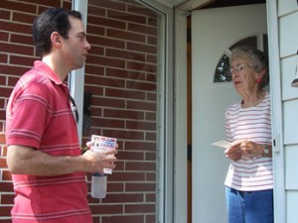
Have any of you ever done summer sales?
(e.g., pest control, satellite TV, magic kitchen tile cleaner, etc.)
Notes:
Image from www.adavidcreation.com

Slide 6

The premise of summer sales is to sell more–no matter how much you’ve sold. It’s completely self-focused, with incentives offered for daily, weekly, or monthly sales goals.
Stories of unethical behavior are quite common in this industry as desperate twenty-somethings push themselves (and their customers) to buy their wares.
Notes:
Image from vikingwanderer.com

Slide 7

The result?
The salesmen typically don’t make as much as they thought; they’re mad.
The customer isn’t generally very well served; they’re also mad.
The company isn’t as successful as they hoped to be; most fold quickly.
Notes:
Image from www.rahkar.ir

Slide 8

Moral
Selfishness is not what we should shoot for–in business, in school, in life
It doesn’t matter how smart you are or how dumb everyone else is
Notes:
Image from pixabay.com

Slide 9

Um…what? Why are we talking about this?
Let’s look into this further
Notes:
Image from www.flickr.com

Slide 10

Notes:
Video may take several seconds to load.
2:55
https://www.youtube.com/watch?v=CJduzYP-cXQ

Slide 11

Case Study
In Patrick Lencioni’s The Five Dysfunctions of a Team, Kathryn (the new manager) is trying to help everyone work together toward a common goal.
Throughout the course of the book, she has to deal with people and their selfish desires.
Notes:
Source: https://en.wikipedia.org/wiki/The_Five_Dysfunctions_of_a_Team#Characters

Slide 12
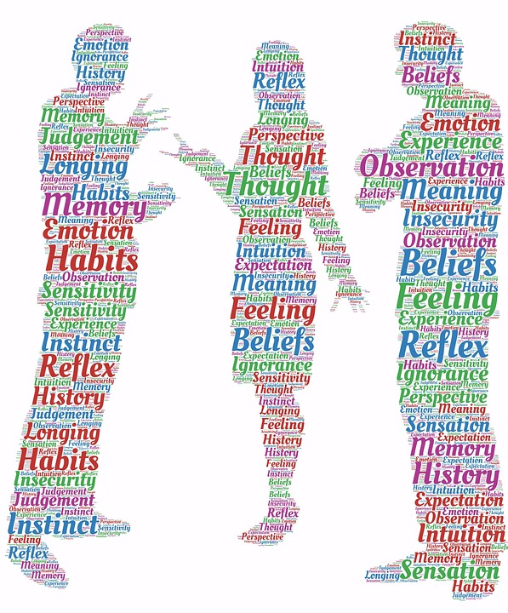
Case Study
Kathryn butted heads with two people: Mikey (Marketing) and Jeff (Sales). Eventually, Mikey decided to go along with the team’s needs, but Jeff wouldn’t budge because he thought his needs were greater. There was an ugly meeting, and Jeff split from the organization in an ugly way.
Notes:
Image from pixabay.com

Slide 13
Group Activity
Discuss the following questions:
Have you seen someone act like Jeff (stubborn, selfish)?
Have you been in a similar situation?
What came of it?
Notes:
Form groups of 2-4

Slide 14

Bottom-line
Selfishness doesn’t just make you no fun to be around–it can destroy your business, your relationships, or your well-being.

Slide 15
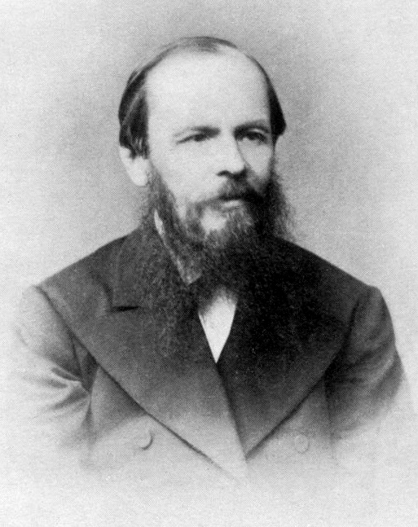
“The world says: ‘You have needs—satisfy them. You have as much right as the rich and the mighty. Don't hesitate to satisfy your needs; indeed, expand your needs and demand more.’ This is the worldly doctrine of today. And they believe that this is freedom. The result for the rich is isolation and suicide, for the poor, envy and murder.” ~Fyodor Dostoyevsky, The Brothers Karamazov

Slide 16
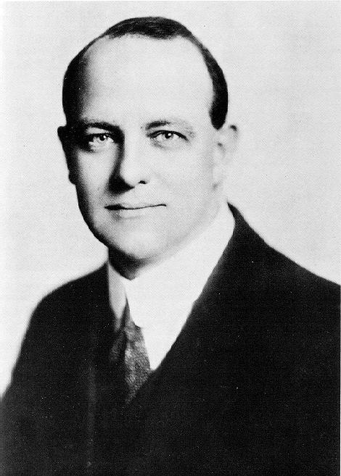
“If there is one thing I dislike, it is the man who tries to air his grievances when I wish to air mine.” ~P.G. Wodehouse, Love Among the Chickens

Slide 17
Class Discussion
What do you think about these quotes?
Are they accurate?

Slide 18


There are entire businesses devoted to helping people overcome selfishness.
Notes:
Ex. The Arbinger Institute
(dedicated to helping clients see others as people, and unselfishly cater to their needs)
Images from www.thereconciliationproject.org, amazon.com

Slide 19
Activity
Who is the most selfish person you know?
Write about that person:
Name (or code name)
Relationship
Triggers (what is this person selfish about?)
On a scale of 1-5 (1 = lowest), how close are you to the person?

Slide 20
Share
Describe the person. (What attributes did you write down?)
What does selfishness do to this person?
How might you be affected if this person were less selfish?
Notes:
Discuss in pairs or small groups

Slide 21
Personal Activity
How selfish are you?
Rate yourself from 1-5
1 = never (“I am unselfish.”)
5 = always (“My needs are more important than others’ needs.”)
What do you think of your ratings?
Can you think of ways that you could be less selfish?

Slide 22
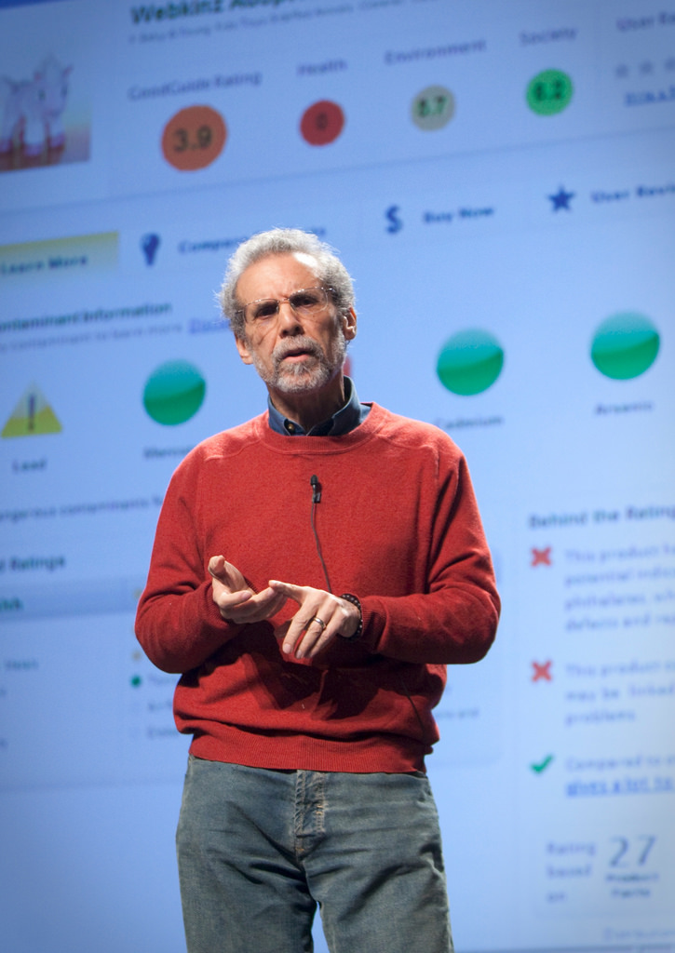
“Self-absorption in all its forms kills empathy, let alone compassion. When we focus on ourselves, our world contracts as our problems and preoccupations loom large. But when we focus on others, our world expands. Our own problems drift to the periphery of the mind and so seem smaller, and we increase our capacity for connection—or compassionate action.”
~Daniel Goleman, Social Intelligence: The New Science of Human Relationships
Notes:
Image from flickr.com

Slide 23

Take-away
Selfish actions can hurt more than just you
If you focus on more than just yourself, you will, ironically, be more successful
Notes:
Image from www.mindfulser.com

Slide 24
The Power of Service

Slide 25
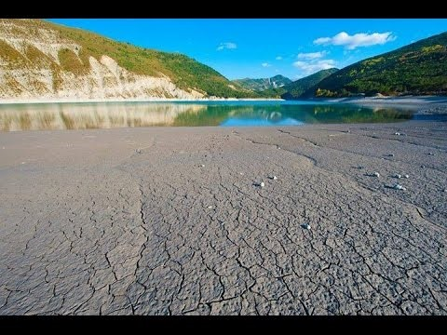
Manoj Bhargava (CEO of 5 Hour Energy)
Notes:
Video may take a few seconds to load.
3:19
Source: https://www.youtube.com/watch?v=se_fYZRbyJs&feature=youtu.be

Slide 26

Reflect
He gives billions of his own money to charity?!?
Would you give ~90% of your own earnings?
Why does he do that?
Notes:
Image from yelneer.com

Slide 27
Discussion
So, it is possible to be massively successful and also selfless. Good to know.
What benefits do you think Manoj Bhargava experiences by being so generous with his money?
What about:
Improved public image for himself, and the company
Increased willingness by customers to purchase product or invest in company
Meeting his goals and making huge improvements in energy, water, and healthcare
Those are exceptional benefits!

Slide 28
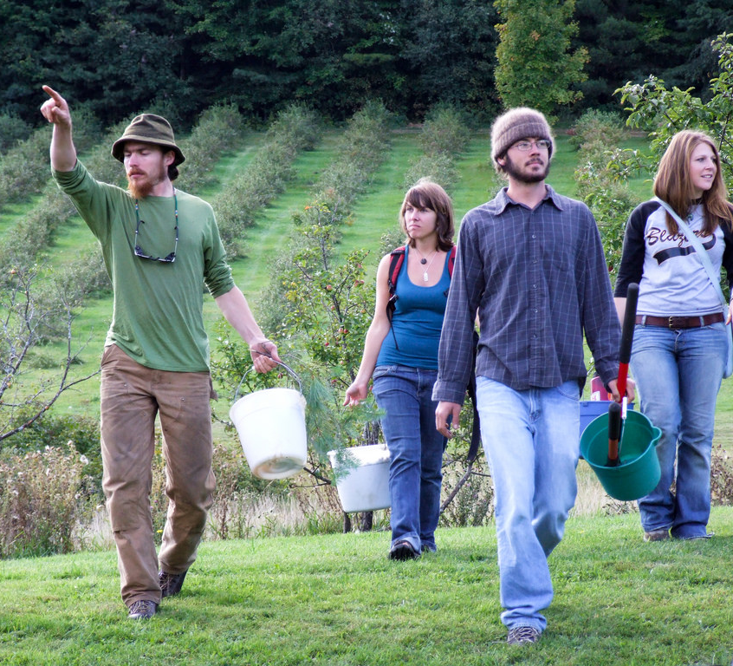
The antidote for selfishness–and all its harmful externalities–is selflessness
Service is an excellent way to forget our needs and focus on others’ needs.
In doing that, we help others–and ourselves.
Notes:
Image from flickr.com

Slide 29

Activity
Write down a summary of the single most meaningful act of service you’ve ever received.
Who gave the service?
When?
Why did they do it?
Notes:
Instructor: “Let’s drive the power of this principle deeper, and talk about times in your lives when you have been served
Hopefully, this will prove the importance and potential benefits of service”
Image from www.lifeofpix.com

Slide 30

Share
Describe the single most meaningful act of service you’ve ever received
Who gave it?
When?
Why?
Notes:
Share in pairs, small groups, or as a whole class
Image from negativespace.co

Slide 31

Share
Describe the single most meaningful act of service you’ve ever given.
Who was it for?
When was it?
Why did you do it?
Notes:
Share in pairs, small groups, or whole class
Image from pixabay.com

Slide 32
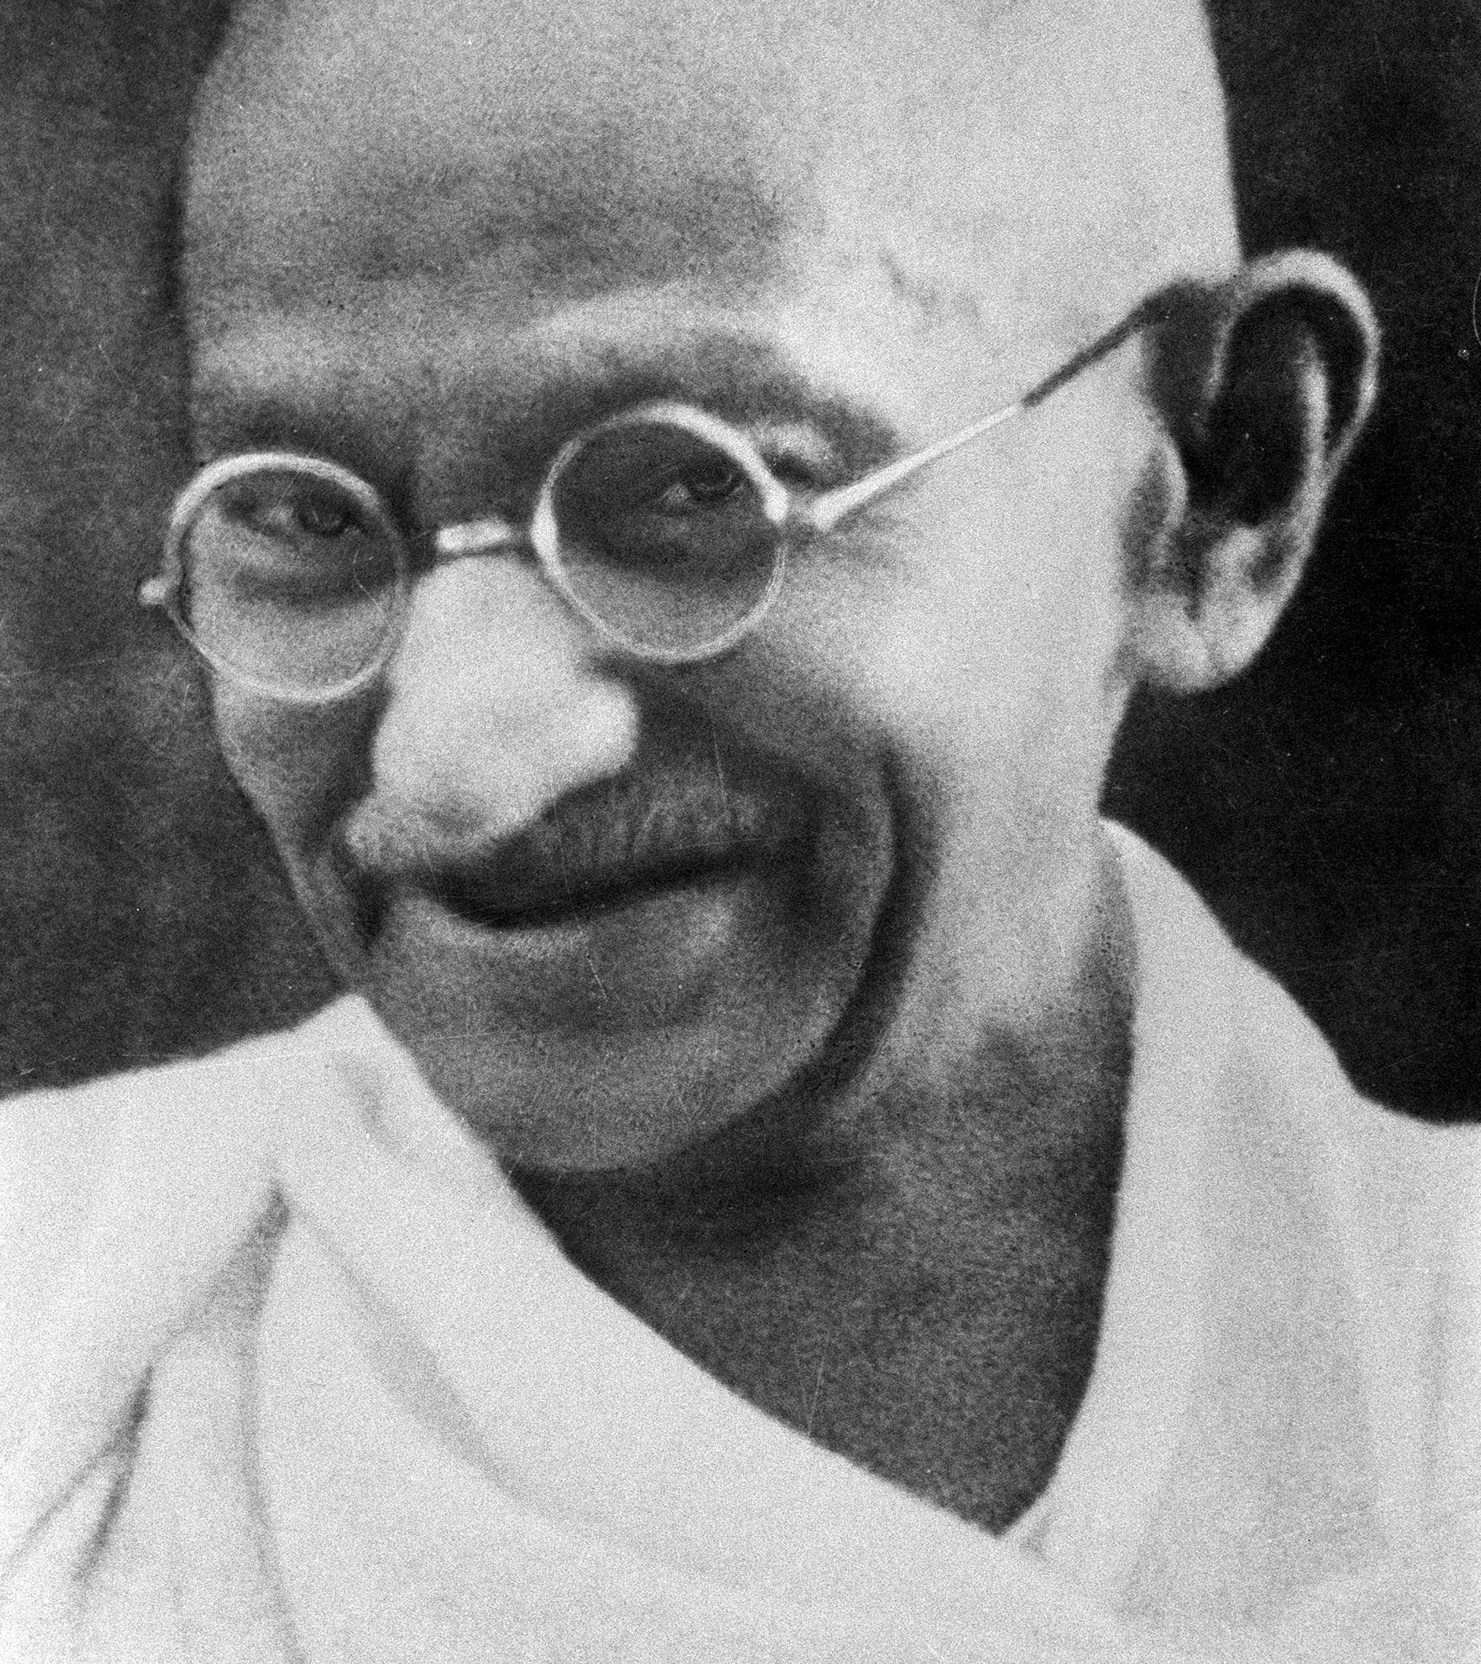
“The best way to find yourself is to lose yourself in the service of others.”
~Mahatma Gandhi
Notes:
Image from en.wikipedia.org

Slide 33
Class Discussion
How will you know when others need something?

Slide 34

Seven Benefits of Service
More happiness
Less stress
Relief from pain
Longer life
Lower blood pressure
Less depression
Career benefits
Notes:
Source: http://www.huffingtonpost.com/kathy-gottberg/volunteering7-reasons-why_b_6302770.html
Image from pexels.com

Slide 35

Invitation
Look for opportunities to serve others, wherever you may find yourself
These can be big or small
Notes:
Image from unsplash.com

Slide 36
Homework
Look for and follow through with one opportunity to serve someone else this week
It doesn’t have to be big—but make it sincere!
Be prepared to talk briefly about what you did next class!

Slide 37
Review
Objectives:
Discuss the problems associated with selfishness
Explore the benefits of service to others

Slide 38
Additional Resources
Patrick Lencioni, The Five Dysfunctions of a Team
Arbinger Institute: https://arbinger.com/
Seven Benefits of Service: http://www.huffingtonpost.com/kathy-gottberg/volunteering7-reasons-why_b_6302770.html
Notes:
These resources have information and examples for effective cover letters and resumes

Slide 39

Content (not images or videos) copyright information:

